Slide 1
Lecture 14: Placement – IV
Tsung-Wei (TW) Huang
Department of Electrical and Computer Engineering
University of Utah, Salt Lake City, UT

Slide 2
Recap: Analytical Placer
Write an equation whose minimum is the placement
If you have a million gates, need a million (xi, yi) values as result
Formulate an appropriate cost function for all the gate-level (xi, yi): F( x₁, x₂, … x_{1M}, y₁, y₂, … y_{1M})
Solve analytically for X*=(x₁, x₂, … x_{1M}), Y*=(y₁, y₂, … y_{1M}) to minimize F( )
The resulting values of X*, Y* give you the placement of all 1M gates
This sounds sort of crazy… but it works great
All modern placers for big ASICs and SOCs are “analytical”
Big trick is write the wirelength in mathematically “friendly” form we can optimize

Slide 3
Recap: Quadratic Wirelength Model
We optimize squared length of “distance” line between points: (x1-x2)² + (y1-y2)²
A “2-point net”
Quadratic wirelength
=(3-1)² + (4-1)²
=13
y=5
4
3
2
1
0
For k-point net, we use the clique model (complete graph for each net)
x= 0 1 2 3 4

Slide 4
Recap: Quadratic Placement Formulation
(0, 1)
(1,1)
1
0 1 10 0 0
1 0 1 1 1
10 1 0 1 0
0 1 1 0 1
0 1 0 1 0
21 -1 -10 0 0
-1 4 -1 -1 -1
-10 -1 13 -1 0
0 -1 -1 4 -1
0 -1 0 -1 3
3
C =
A =
4
Weight=10
5
2
Weight=10
b_{x} = 0
0
1
1
0.5
b_{y} = 10
0
0
1
0
(1,0)
(0.5,0)
All wire weights = 1 except two highlighted:
gate1 to pad and gate1 to gate2

Slide 5
Recap: Quadratic Placement Result
Placement → Solving a linear system

Slide 6
Recap: Two Practice Examples
(0, 1)
(1,1)
(0, 1)
(1,1)
1
3
1
3
4
4
2
5
2
5
(1,0)
(1,0)
(0.5,0)
(0.5,0)
All wire weights = 1
All wire weights = 1

Slide 7
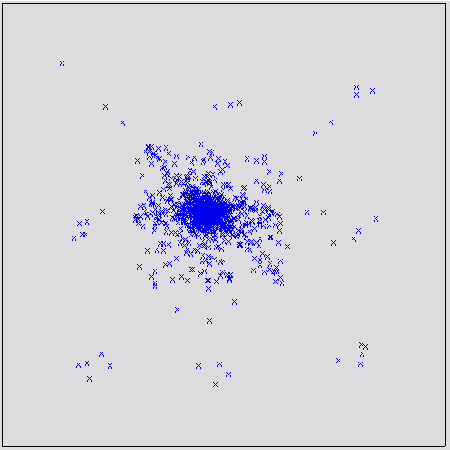
How does Quadratic Placement Look?
Like the right figure:
Small IBM ASIC, few thousand gates
All lumped together to give the minimum wirelength
New problem:
Quadratic model minimizes wirelength for big netlists, in a numerical way
But ignores that gates have physical size, cannot be on top of each other
Now, we have to fix this…
Our solution: recursive partitioning

Slide 8
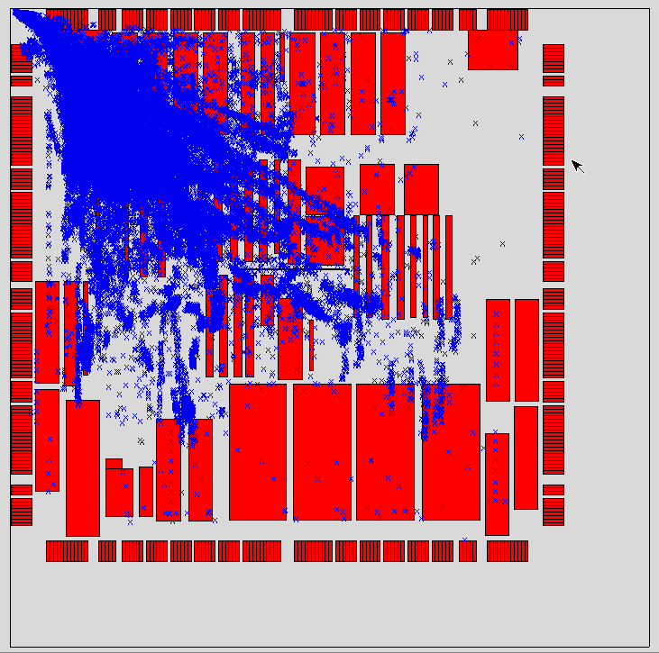
A Bigger Industrial Example
This benchmark is from IBM
210,904 gates (blue)
543 fixed blocks (red) –like SRAMS
Image shows where gates “want” to go if we model blocks like “big pads”
This is a quadratic placement of gates
Additional problems: gates need to go between these blocks!
Why we are showing this?
Example of how badly imbalanced the quadratic placement can be

Slide 9
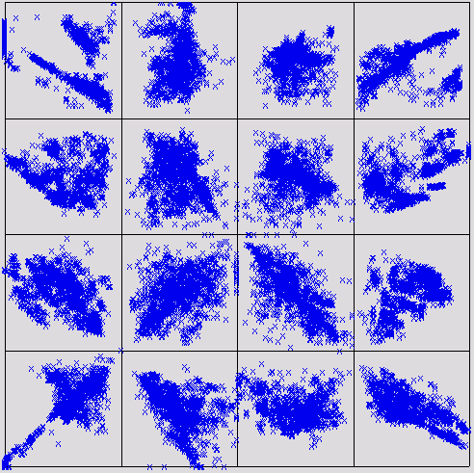
Recursive Partitioning
1st quadratic place (QP) solve
Partition chip into left / right. Select which gates on each side.
Solve 2 new, smaller QP tasks
Repeat. Partition each side top/bottom.
Solve 4 new smaller QP solves
Just keep going
Notes:
Now we know the problem of this unbalanced situation is caused by only targeting wirelength minimization. In our formulation, we only have wirelength in our objective function. When you optimize it, of course, the solution will try putting everything together, because if two points overlap, their wirelength is minimized to zero.
A famous way to solve this problem is to recursively partition the chip and apply density constraint to balance the cells. Remember what you did in the first programming assignment, the FM partition, you need to follow the balance constraint, right. You can not have, say, 50 cells going to one partition and 1000 cells going to another partition.
When we partition the cells to two region, like this example here, we can force those cells in one partition to stay there. If you are partitioned to this region, stay there in the next iteration when we optimize your quadratic wirelength. We can do this by creating artificial pads on the partition boundary as force to pull you out of overlap.
Then, we keep doing this until all partitioned regions can accommodate cells without any overlap. (explain …)

Slide 10
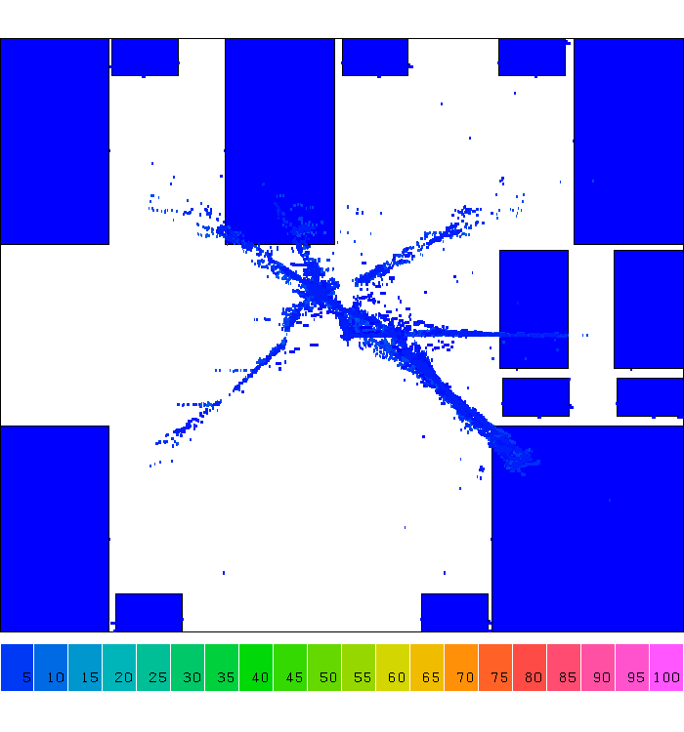
Example: Partition-based Placement
Notes:
The whole process looks like this.

Slide 11
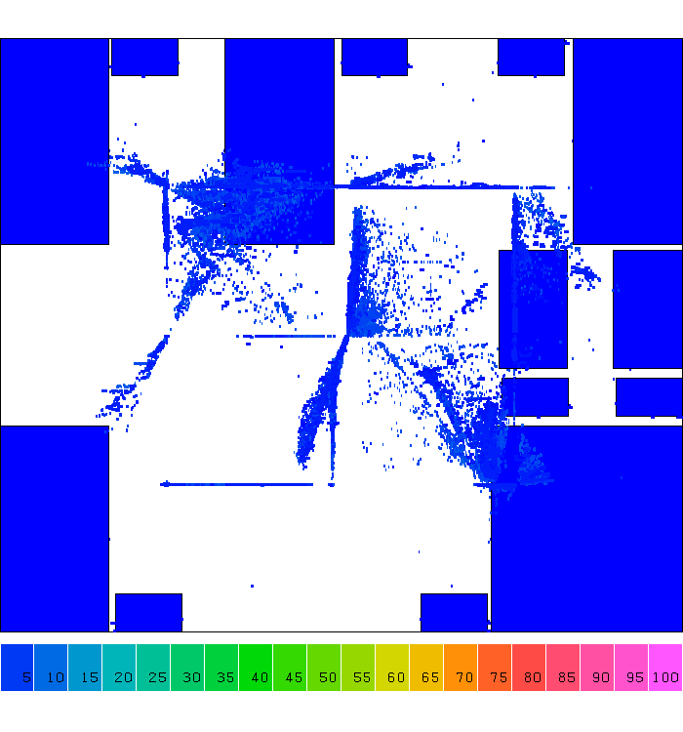
Example: Partition-based Placement

Slide 12
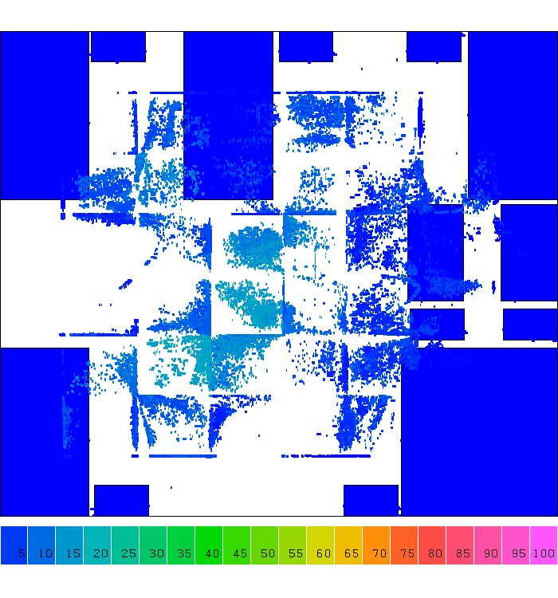
Example: Partition-based Placement

Slide 13
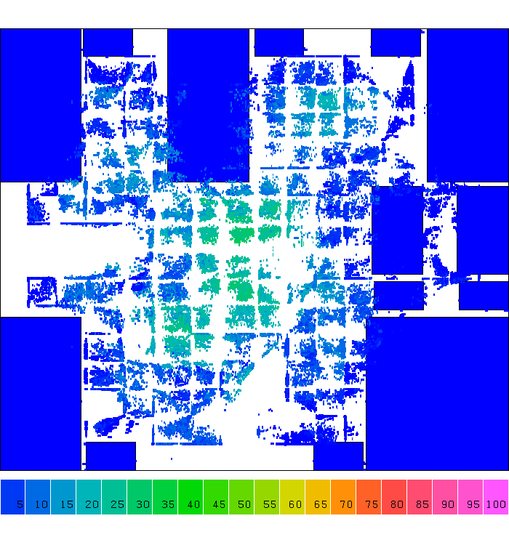
Example: Partition-based Placement

Slide 14
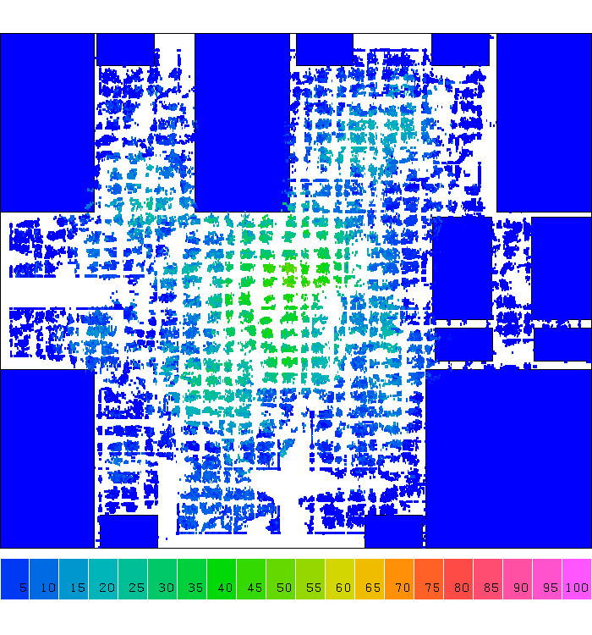
Example: Partition-based Placement

Slide 15
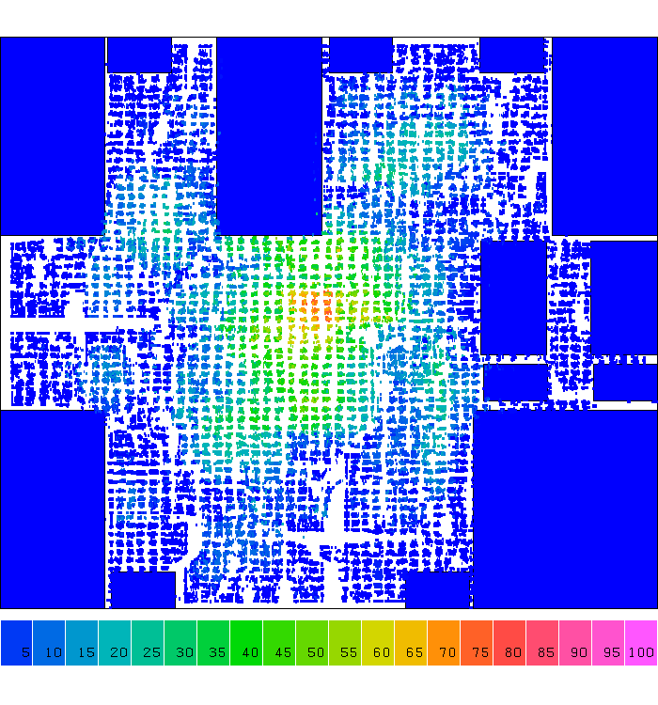
Example: Partition-based Placement

Slide 16
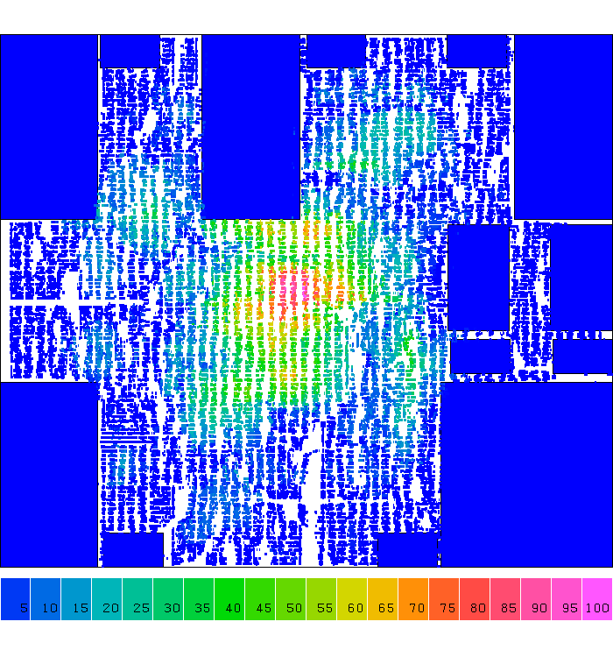
Example: Partition-based Placement

Slide 17
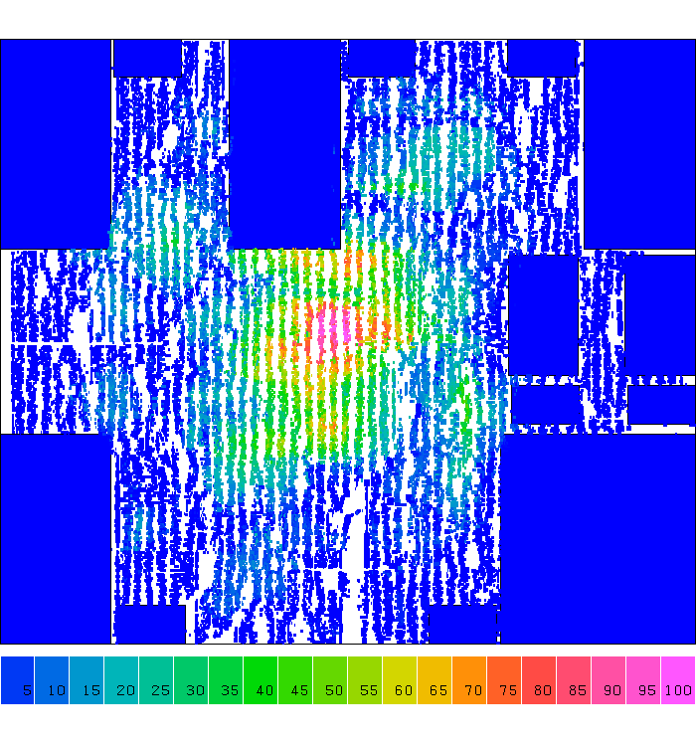
Example: Partition-based Placement
Notes:
So, this is the final placement solution. You can still see the partition boundary like a 2D grid layout, placing all cells in a very regular fashion.

Slide 18
Recursive Partition
After 1st quadratic placement (QP), divide chip area exactly in half, vertically (horizontal is ok too)
We want half the gates on each side
Notes:
Now, let’s take a look how this partition-based placement can help us resolve the overlap problem. At each iteration, we will first formulate the placement problem in to a quadratic wirelength minimization problem and solve it. Then, we get a bunch of gate locations, potentially, with many overlaps.
For example, (explain …)
(click) Now, after we found the locations from the system solver, we will divide the chip area exactly in half, either vertically or horizontally, since we are working on a 2D layout. Then, what do we want? We want half of the gates on each side, so we can balance the density, right?

Slide 19
Recursive Partitioning: How to Assign?
What if QP does not spread gates evenly between halves?
How do we know which gates to put left vs right if this is initial QP?
We partition region at exact center. How do we reformulate a new QP to re-do the gates on each side?
Notes:
But, how do we assign? You know, in this example we have seen before, the solution of quadratic wirelength optimization does not appear to spread gates evenly. There are many overlaps.
Now, if I apply a vertical cut, I need to make the distribution even on both side. How do we do that? Like this example here (explain the text below …)

Slide 20
Recursive Partitioning: How to Assign?
Sort placed gates on X coordinate, then Y (for horizontal cut – sort on Y first, then X); If N total gates, then first N/2 in sorted list go on left; others on right
Sorted on X coordinate, these are left-most N/2 of N gates
This sorting assigns which gates go left, and go right
Notes:
Intuitively speaking, if you are far from the partition boundary, we should keep you in your location instead of moving you to another partition. Likewise, if you are close to the partition boundary, you might prefer to go to another partition.
So, we can sort placed gates on X coordinate (explain …)
Now what?

Slide 21
Recursive Partitioning: How to Assign?
R
R
Focus on the gates inside this shaded region R on the left side of the cut.
New big questions:
(1) How do we keep the gates assigned to left side actually in the left side?
(2) How do we model wires that connect to gates/pads on right? Can’t ignore these!
Notes:
Once we have move those cells to the right part or left part, depending on the unbalanced situation, we can focus on the gates inside their region to formulate the optimization problem.
But, here we have new big questions. (explain …)
(ask students to think about this)

Slide 22
Recursive Partitioning: How to Contain?
Idea: Pseudo-pads
Every gate & pad not inside region R is modeled as a pad on boundary of R
Propagate these outside gates using their current (x,y) location to nearest point on R;
For this example, we take the y coordinate, and put pad on center of cut line x
R
R
Solution: model gates/pads on right as “fake” pads on left.
Resulting new QP problem for gates in left region
Notes:
Well, the idea is to create pseudo-pads for them. From the examples we have seen before, pads are fixed location that drives a force to pull a gate toward its location. It the pad or the driving force stops at the boundary, then the gate will not be pulled out of the boundary, right?
So, every gate and pad not inside a region R will be modeled as a pad on boundary of R (explain …)

Slide 23
Why this Works?
Cannot ignore gates outside region we are re-placing
Want gates inside to feel pull from wires to gates outside region
Pseudo-pads do this for us
Pseudo-pads guarantee all gates re-locate inside region
Think of wires as ‘springs’ that each pull gates toward other gates or pads
If pads (real & pseudo) are on edges of region – QP keeps gates inside
Notes:
Why this works?

Slide 24
Example
a
a
a
1
2
1
placed
1
5
b
5
5
b
b
4
2
4
2
3
4
3
3
c
c
c
1. Initial netlist
5 gates (1,2,3,4,5)
8 wires
3 pads (a,b,c)
2. Initial QP
3. First partition
Sort on X:
Gate order 1 5 4 3 2
Pick: 1 5 4 on left
Notes:
Let’s take a look at an example. (explain …)

Slide 25
Example (cont’d)
Note: do not propagate pad b, since no wires on left connect to it
placed
a
a
a
1
1
1
5
5
5
b
4
2
2
4
2
4
2
3
3
3
3
c
c
c
4. Propagate gates/pads
Right-side gates: 2,3
Right-side pads: b
Push to cut, using y coordinates
5. 2nd QP input
This is set up for this new smaller placement
6. 2nd QP solved
New placement

Slide 26
Example (cont’d)
a
placed
a
placed
placed
1
1
1
1
1
5
2
2
2
5
5
5
5
b
b
b
b
2
4
4
4
3
4
3
4
3
3
c
c
c
c
c
7. Left side placed.
Now, re-place right-side gates.
8. Propagate gates/pads
This is set up for next, new smaller placement
9. 3nd QP input
This is set up for this new smaller placement
10. 3nd QP solve

Slide 27
Example (cont’d)
Note: do not propagate pad b, no wires to 1,5
Note: gates 2,3 propagate to corner of new region: closest point
a
placed
placed
a
a
placed
1
1
1
5
5
b
5
b
b
2
2
4
2,3
2
4
4
4
3
3
3
c
c
c
Repeat: Horizontal
partition on left
Focus on top. Sort gates on Y
Assign gates 1,5 to region.
Propagate gates & pads
Note: gate 4 propagates up to bottom of new region

Slide 28
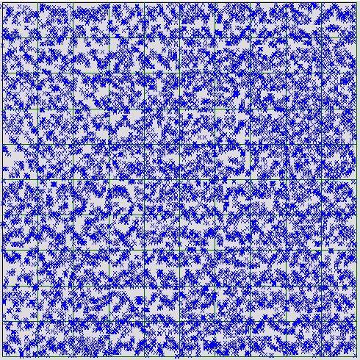
Keep Repeating this Recursion
Keep recursively partitioning…
Usually, you continue until you have a “small” number of gates in each region
Small >> 1 typically. 10-100 for example
Get a good, “global” placement, but not a “final” placement
a
placed
placed
1
2
5
b
4
3
placed
placed
c
Continue…

Slide 29
Final Placement Step: Legalization
Still need to force gates in precise rows for final result
QP methods cannot force individual gates into standard cell rows, without overlaps
Solution step is called: Legalization
Many different algorithms. One easy way to do this is by annealing!
Do local improvement based on swaps of nearby gates
To anneal, set T=HOT to be very small (cold), so don’t disrupt QP result
Notes:
Final placement needs to be a valid solution. What we did was to decide rough locations of cells while satisfying balance constraint, which is also called global placement. So, the solution from global placement still has overlaps unless you really do the partition to the very fine-grained level like each partition can have only one cell then you don’t have the overlap problem.
To remove all these overlaps, there is another stage of algorithm called legalization. The goal of legalization is to find the exact locations of gates such that no overlaps will happen, like this example, no overlap.
And there are many different algorithm for legalization, and it is very similar to the game, Tetris, you play when you were little. As you can already imagine, one easy way to do this is by annealing. (explain …)

Slide 30
Summary
We have discussed problems of plain quadratic placement
Gates are easily lumped together to minimize wirelength
We have discussed a solution: partition-based placement
Partition the placement region iteratively
Introduce auxiliary pads between partition boundaries
We have discussed legalization
Remove all overlaps among gates
Improve wirelength in a local region (e.g., rows)

